Slide 1
XML Messaging with Raw XML
Service-Oriented Software Engineering
Software Institute
Nanjing University
Bei Jia

Slide 2
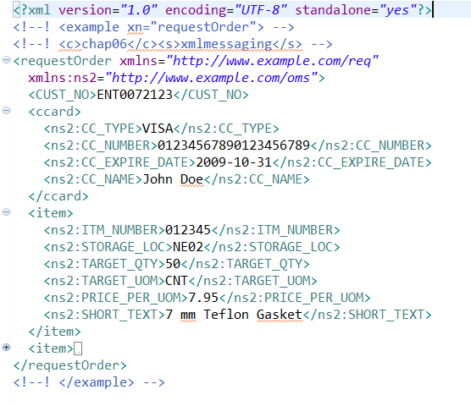
XML Messaging with Raw XML requestOrder.xml
JAX-WS provides the javax.xml.ws.Dispatch<T> interface provide support for XML messaging interactions with Web services, which provides support for the dynamic invocation of Web services

Slide 3
XML Messaging with Raw XML Client.java
XML Message to invoke operation
…
StreamSource xmlSource =
new StreamSource(new StringReader(xmlByteArray.toString()));
// create Service
URL wsdlURL = new URL("http://"+host+":"+port+
"/chap06-endpoint-endpoint-1.0/requestOrder?wsdl");
QName serviceQName =
new QName("http://www.example.com/req", "RequestOrderService");
Service service = Service.create(wsdlURL, serviceQName);
// create Dispatch<Source>
QName portQName =
new QName("http://www.example.com/req", "RequestOrderPort");
Dispatch<Source> dispatch = service.createDispatch(portQName,
Source.class, Service.Mode.PAYLOAD);
Source orderSource = dispatch.invoke(xmlSource);
JAXBContext jc = JAXBContext.newInstance(RequestOrderResponse.class);
Unmarshaller u = jc.createUnmarshaller();
RequestOrderResponse response =
(RequestOrderResponse) u.unmarshal(orderSource);
…
Factory to create Dispatch instances
Create Dispatch instance
The Invoke
Type parameter(javax.xml.transform.Source, javax.xml.soap.SOAPMessage, Object)
Mode parameter(javax.xml.ws.Service.Mode.MESSAGE , javax.xml.ws.Service.Mode.PAYLOAD)

Slide 4
XML Messaging with Custom Annotated JAXB Classes Client.java
Another approach to XML messaging involves writing your own JAXB annotated classes to represent the XML messages that are sent and received from a Web service, without using SEI generated by JAX-WS
…
JAXBContext ctxt = JAXBContext.
newInstance(MyRequestOrder.class, MyRequestOrderResponse.class);
QName portQName =
new QName("http://www.example.com/req", "RequestOrderPort");
Dispatch<Object> dispatchJAXB = service.createDispatch(portQName,
ctxt, Service.Mode.PAYLOAD);
// create the custom request order object
MyRequestOrder myReq = new MyRequestOrder();
myReq.ccard = createMyCreditCard();
myReq.item = createMyItemList();
myReq.CUST_NO = "ENT0072123";
myReq.PURCH_ORD_NO = "";
MyRequestOrderResponse resp =
(MyRequestOrderResponse) dispatchJAXB.invoke(myReq);
…
Accepts a JAXBContext
An instance of JAXB class

Slide 5
XML Messaging with Custom Annotated JAXB Classes MyRequestOrder & MyRequestOrderResponse
…
@XmlAccessorType(XmlAccessType.FIELD)
@XmlType(namespace = "http://www.example.com/req")
@XmlRootElement(name = "requestOrder",
namespace = "http://www.example.com/req")
public class MyRequestOrder {
protected String CUST_NO;
protected String PURCH_ORD_NO;
protected MyCreditCard ccard;
protected List<MyItem> item;
}
…
@XmlAccessorType(XmlAccessType.FIELD)
@XmlType(namespace = "http://www.example.com/oms")
@XmlRootElement(name = "requestOrderResponse",
namespace = "http://www.example.com/req")
public class MyRequestOrderResponse {
protected OrderType Order;
}

Slide 6
Invocation with Custom Java/XML Mappings
Besides JAXB, we can marshal java to XML with other Mapping tools, such as Castor and call Web Service with Dispatch<T>.invoke(), And unmarshal the XML returned
Sample Code
  CreditCard.java
  MyRequestOrder.java
  Mapping.xml (used by Castor)
  Client.java

Slide 7
Invocation with Custom Java/XML Mappings CreditCard.java & MyRequestOrder.java
…
public class CreditCard {
public String type;
public String num;
public String expireDate;
public String name;
public float amount;
public String chargeDate;
…
…
public class MyRequestOrder {
protected String custno;
protected String purchordno;
protected CreditCard ccard;
protected List<MyItem> itemList;
…

Slide 8
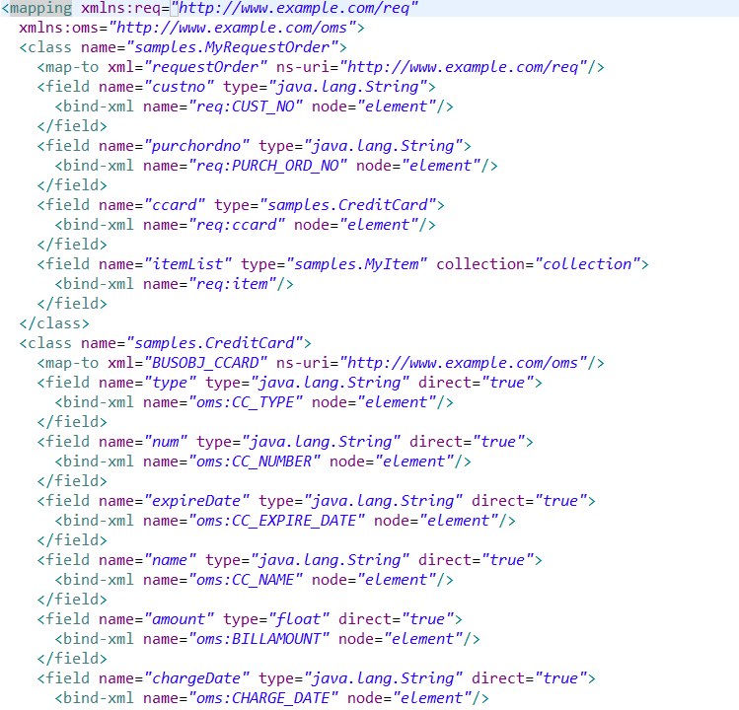
Invocation with Custom Java/XML Mappings Mapping.xml

Slide 9
Invocation with Custom Java/XML Mappings Client.java (1/2)
…
String host = args[1];
String port = args[2];
// load Castor Mapping File
FileInputStream castorMappingFile = new FileInputStream(args[0]);
Mapping castorMapping = new Mapping();
castorMapping.loadMapping(new InputSource(castorMappingFile));
// Use Castor to marshal MyRequestOrder to XML
MyRequestOrder requestOrder = createRequestOrder();
ByteArrayOutputStream ba = new ByteArrayOutputStream();
Marshaller m = new Marshaller(new OutputStreamWriter(ba));
m.setMapping(castorMapping);
m.marshal(requestOrder);
Source xmlSource = new StreamSource(new StringReader(ba.toString()));
…

Slide 10
Invocation with Custom Java/XML Mappings Client.java (2/2)
…
// create Dispatch<Source>
URL wsdlURL = new URL("http://"+host+":"+port+
"/chap06-endpoint-endpoint-1.0/requestOrder?wsdl");
QName serviceQName =
new QName("http://www.example.com/req", "RequestOrderService");
Service service = Service.create(wsdlURL, serviceQName);
QName portQName =
new QName("http://www.example.com/req", "RequestOrderPort");
Dispatch<Source> dispatch = service.createDispatch(portQName,
Source.class, Service.Mode.PAYLOAD);
// invoke web service with Castor generated XML
Source orderSource = dispatch.invoke(xmlSource);
…

